Slide 1





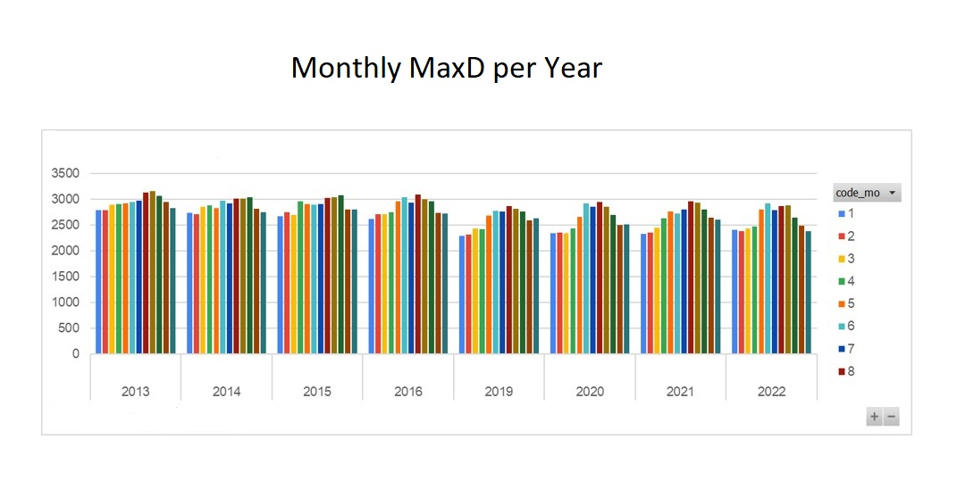
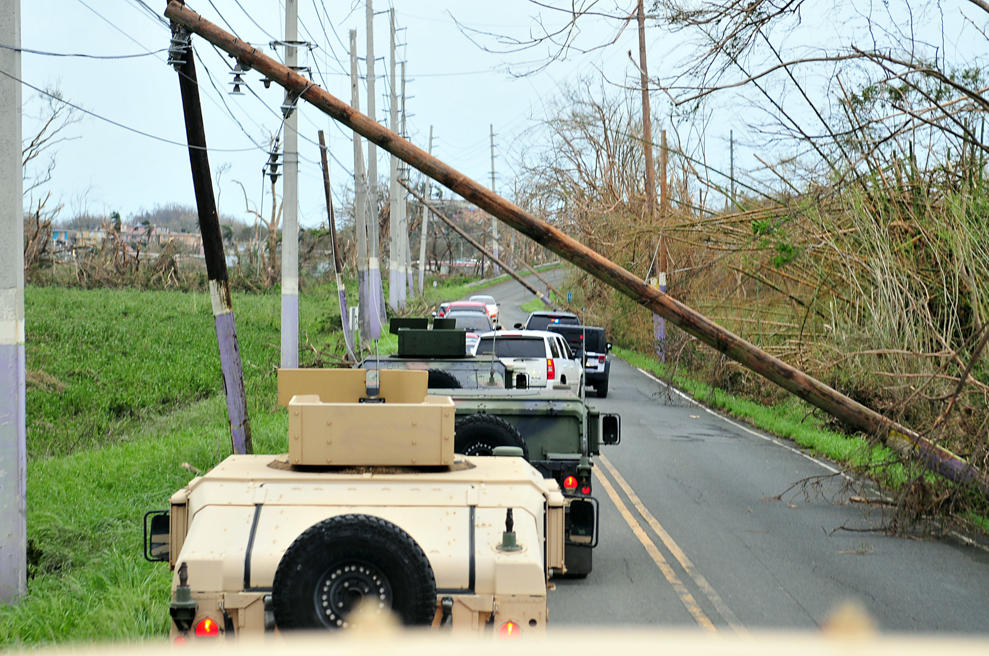
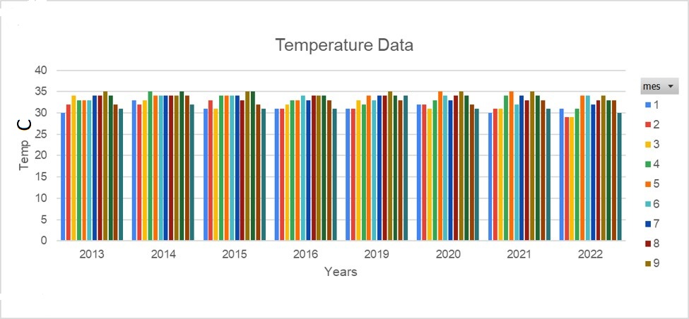
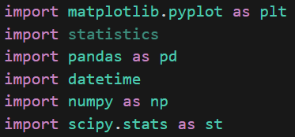
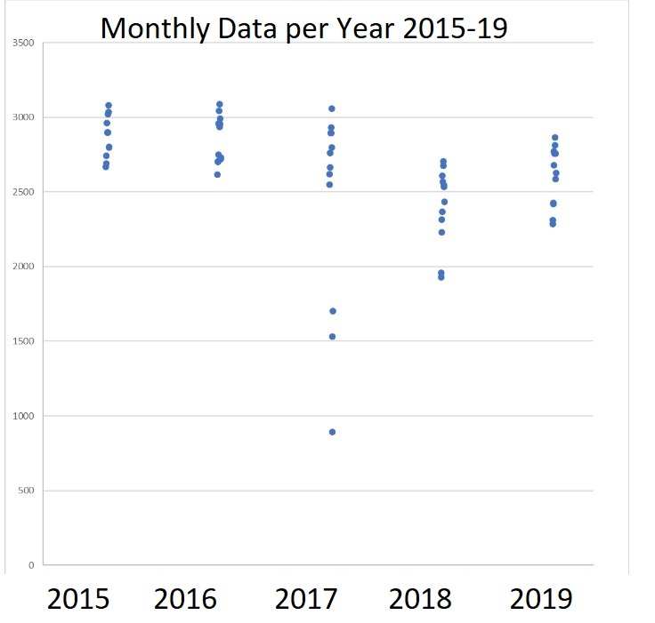
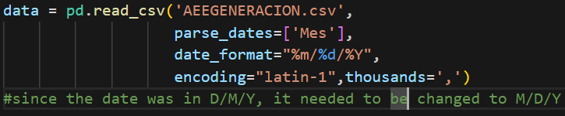
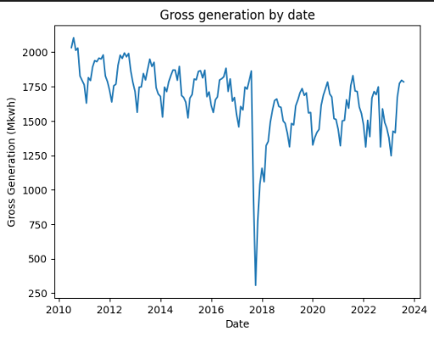
Data Analysis of the Electrical Power System in Puerto Rico (2011, 2022)
Authors Onix Gonzalez, Daniel Barreiro Faculty Mentor: Dra. Carmen Caiseda, Prof. Jorge Feliciano Inter American University of Puerto Rico, Bayamon Campus, Instituto Tecnologico de PR-Manati email: emgonzalezco@itec.pr, dbarreiro3939@interbayamon.edu
Problem Statement
The devastation of Puerto Rico’ Maria period, underscores the importance of the resilience of this system. Using tools, such as Python and Excel, we have been able to quantify how catastrophic this s electrical grid during the hurricane event was and the current state of our electrical grid.
Figure 1: Electrical System Damage
U.S. Department of Defense Current Photos1st Sgt. Waldemar Rivera/Puerto Rico National Guard - 170921-A-ZM725-898, Public Domain.
Dataset Analysis [1]
The team selected a dataset published monthly by AEE with 29 variables and n=258 datapoints (7/2011-8/2023). Data for the selected variables in Table 1 was complete, organized and visualized from 2012 to 2022.
Table 1: Variables studies monthly from 1/1/2012 to 12/1/2022
Excel Visualizations of Max Demand and Weather Data
Figure 2: Monthly Maximum Demand from Years 2015-2019
Climate data was also obtained and compared to the Maximum Demand data to better understand the patterns.
The following visualizations show seasonality of Maximum Demand.
Figure 3: Seasonality of Maximum Demand from Years 2013-2016, & 2019-2022
Figure 4: Seasonality of Peak Temperature Weather Data of PR for Years 2013-2016, 2019-2022
Python Visualizations of Gross Generation Data
The Gross Generation data was analyzed using Python in Visual Studio Code, using libraries such as panda (Data Frames), scipy.stat (Statistics) and matplotlib (visualizations).
Figure 5: Code snippet of library imports and date formatting in Python
Figure 6: Gross Generation Data Visualization
Inference Statistics
After visualization of variables MaxD and GGen, data was organized into two groups: Pre-Maria (1/1/2011 to 12/1/2016) and Post-Maria (1/1/2019 to 12/1/2022).
Various date-formatting functions were needed in Python to separate data into pre-post Hurricane Maria groups and conduct a two-sample T-Test with Unequal variance for MaxD and Equal variance for GGen (according to F-Test) in Table 2.
()
Table 2: One-tail T-Test results for MaxD and GGen variables
CONCLUSIONS
We conclude that the Post-Maria MaxD and GGen variables means are statistically significantly smaller than its corresponding Pre-Maria values. This suggests at least two scenarios:
our electrical gross generation has not recuperated from the damage produced by Hurricane Maria
the maximum demand may be affected by clients unable to consume energy because of frequent blackouts
some clients have the option to choose renewable energy options such as solar energy
Future Work
Use regression and baseline data as a reference for disaster identification.
Use of Machine Learning algorithms and regression models to predict maximum demand, particularly using weather data.
Identify ways to contribute to built resilience in communities that have greater risk and less resources.
References/Acknowledgements
We acknowledge funding from the NSF-20-599 Award No. 2150195, PI-Dr. Edouard Tchertchian, Mentor Dr. Carmen Caiseda, IAUPR-Bayamon Campus and Prof. Jorge Feliciano, ITEC-Manati for the opportunity, and support.
Datasets - DANIEL
Weather data website Weather Spark https://es.weatherspark.com/y/150269/Clima-promedio-en-Puerto-Rico-durante-todo-el-a%C3%B1o
Estado de Situación Energética del País Informe Anual 2014 Oficina Estatal de Política Pública Energética, ELA http://www.estadisticas.gobierno.pr/iepr/LinkClick.aspx?fileticket=M53Ieo1-ots%3d&tabid=186
Other pertinent references used - DANIEL
Measure | MaxD (Pre,Post) | GGen (Pre,Post)
Mean ± t-critical* SE (Pre,Post) | 2940 ± 31.15 2627 ± 50.12 MW | 1787 ± 23.11 ± 34.43 M kWh
Variance Pre Variance Post | 2.52 E4 4.36 E4 | 1.40 E4 2.07 E4
Observations (Pre,Pos) | (72 48) df=82 | (72,48) df=118
T-stat P-value – One-tail | 8.84 7.48 E-14 | 9.19 8.04 E-16
Variable | Description | Units
Maximum Demand (MaxD) | Maximum power demand during the month | MW
Gross Generation (GGen) | Total amount of electric energy produced by generating units and measured (MkWh) during a month | MkWh

